Slide 1

Can adding new hubs ensure meeting sustainability goals while minimizing cost?
Nathaniel Mitrani, Alex Serrano, Joel Sole, Jan Tarrats
JNA Datathon 2022

Slide 2

Business case
Optimization of chain robustness: disaster aversion, risk modeling
Optimizing costs and emissions in supply chain
Port -> Hub -> City
Recommend best hub to pass by
Hub creation, what are the possibilities and the benefits?
CO2
CO2
PORT
HUB
CITY
COST $
COST $

Slide 3


Risk aversion & disaster prediction
Know whether an order will be late -> damage control
Privilege minimum lateness routes
Evaluate partnerships based on model results

Slide 4
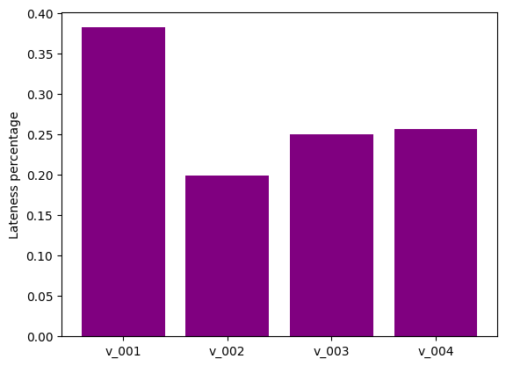
Third party logistics: Best & Worst

Slide 5


Optimize cost and emissions
Minimize cost ($) and emissions (CO₂ )
Define Greediness parameter 𝞪: percentage of privilege given to reduce cost over emissions (Examples)
How to optimize the supply chain in terms of our Greediness parameter 𝞪 ?

Slide 6
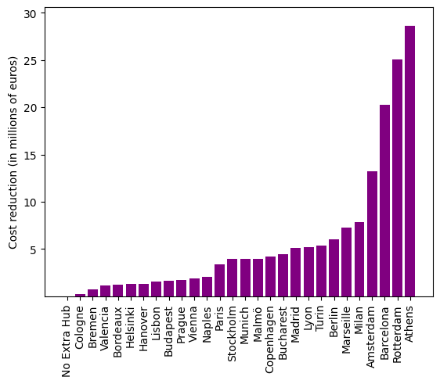
Minimizing cost: Maximum Greediness
Maximum Cost Reduction
Amsterdam 13.12 millon euros

Slide 7
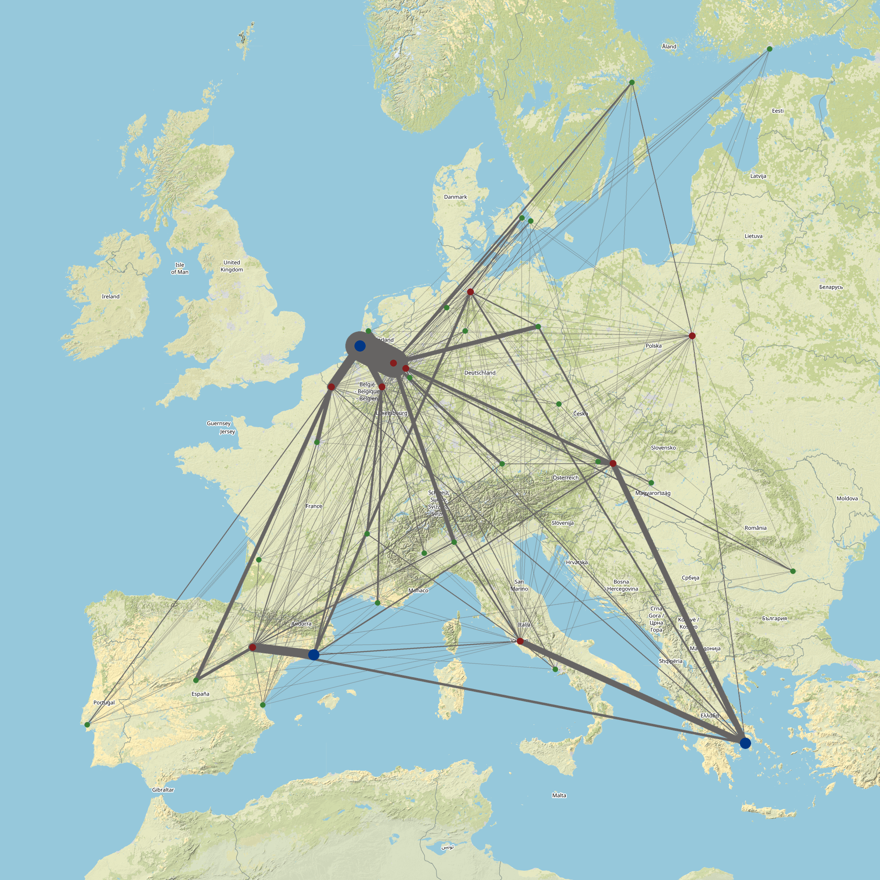
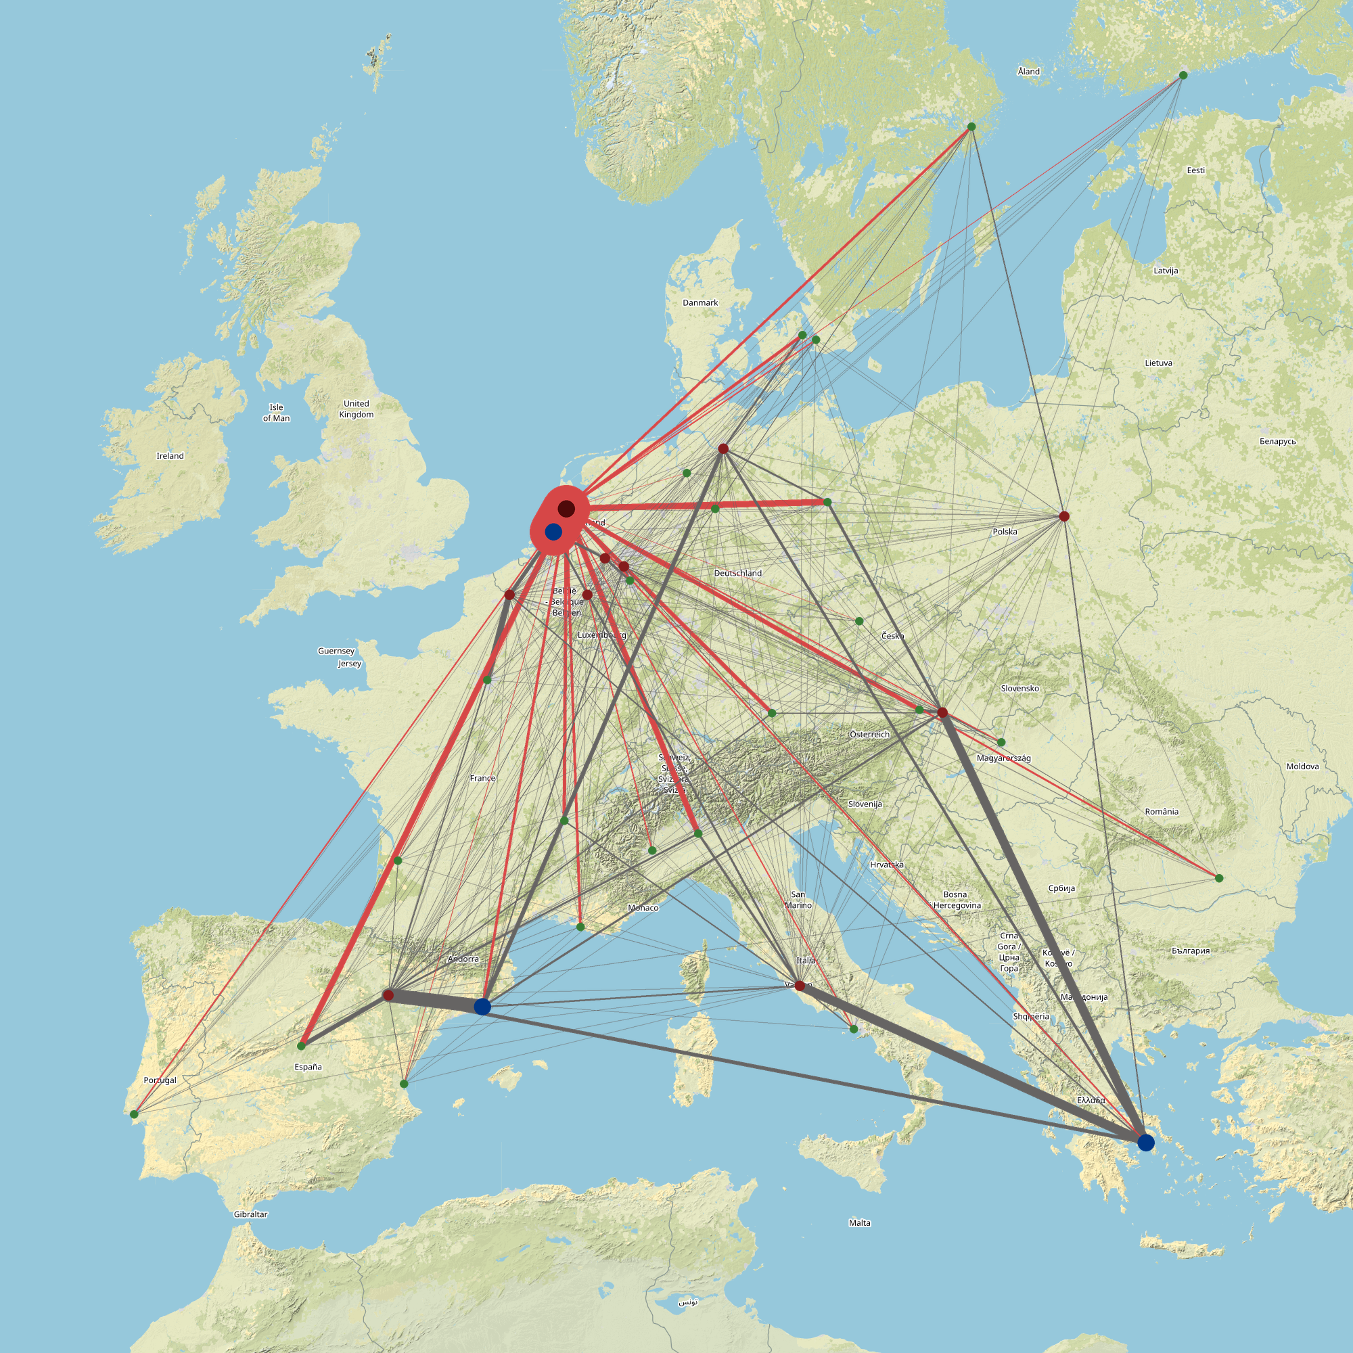
Minimizing cost: Maximum Greediness, Map
Amsterdam

Slide 8
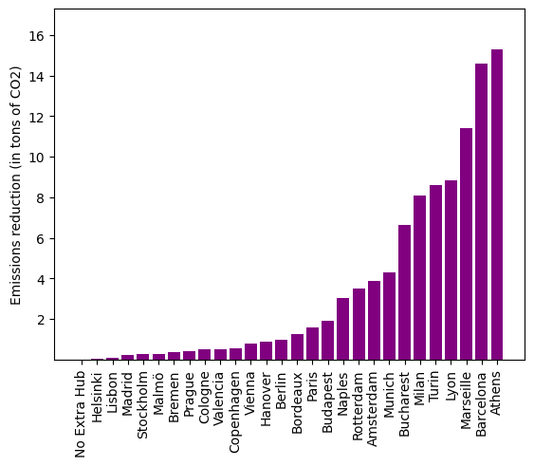
Reduce emissions : Least Greediness
Maximum Emissions Reduction
Marseille 11.4 CO2 tons

Slide 9
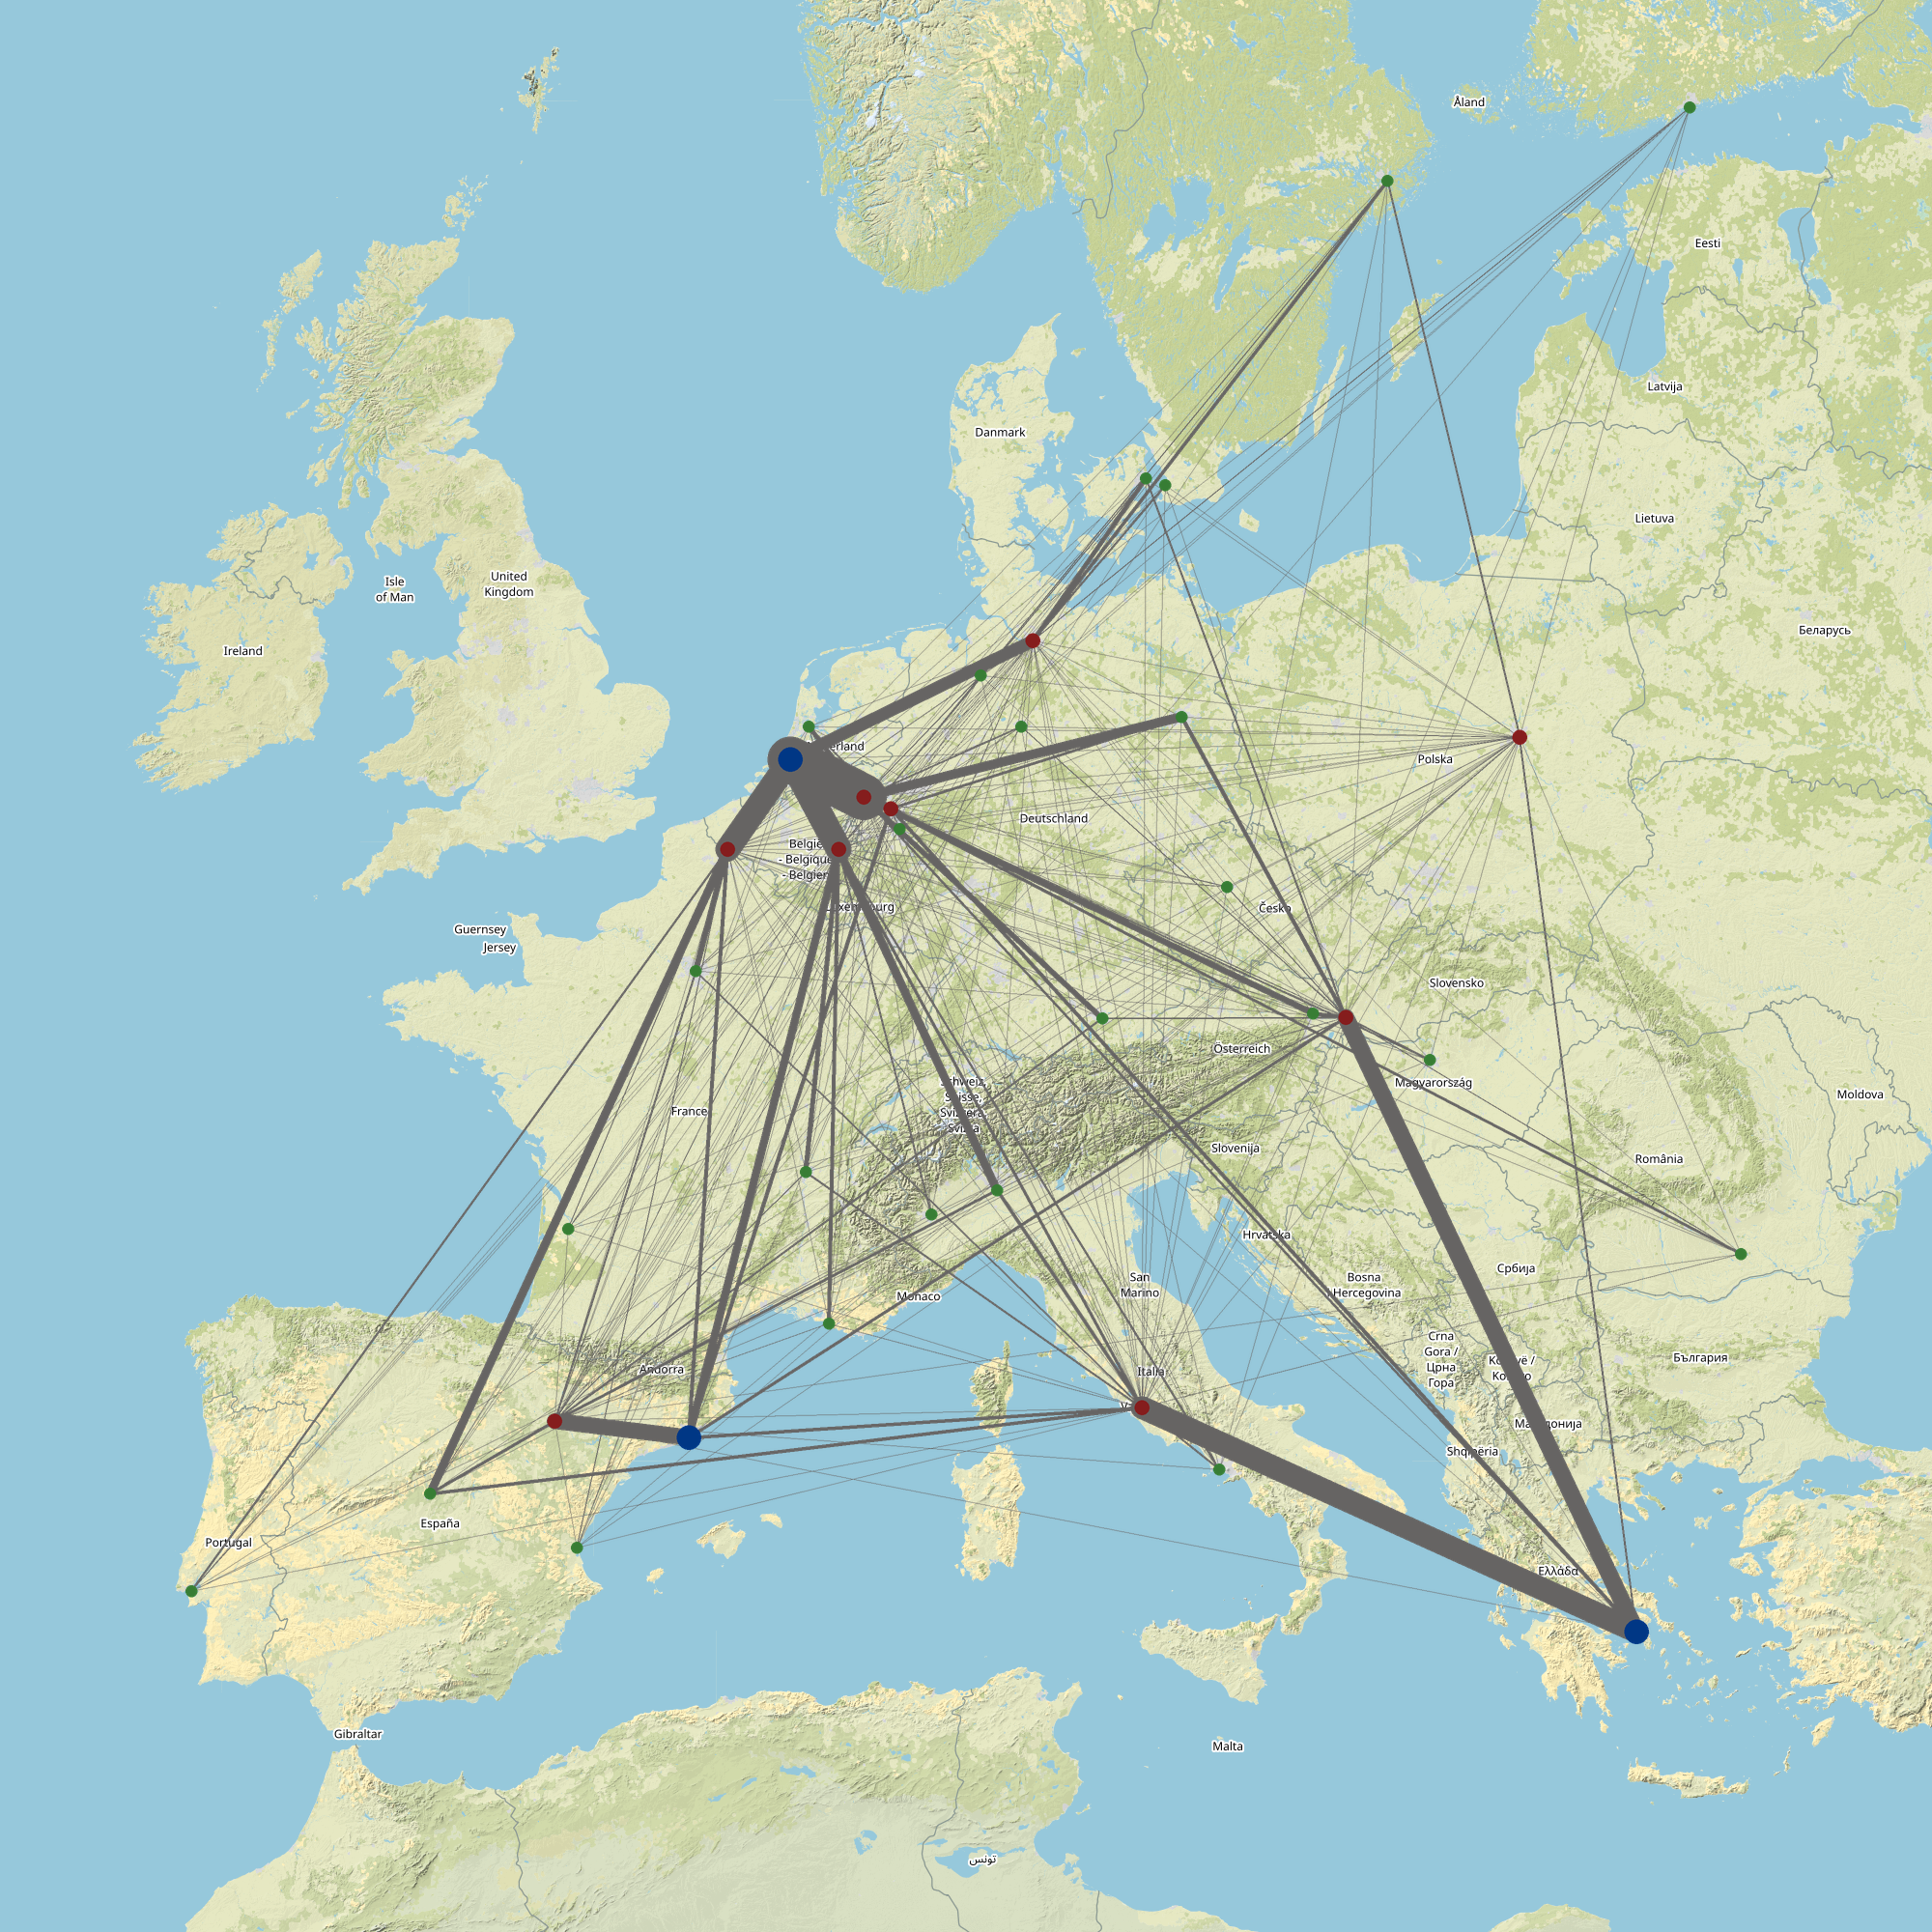
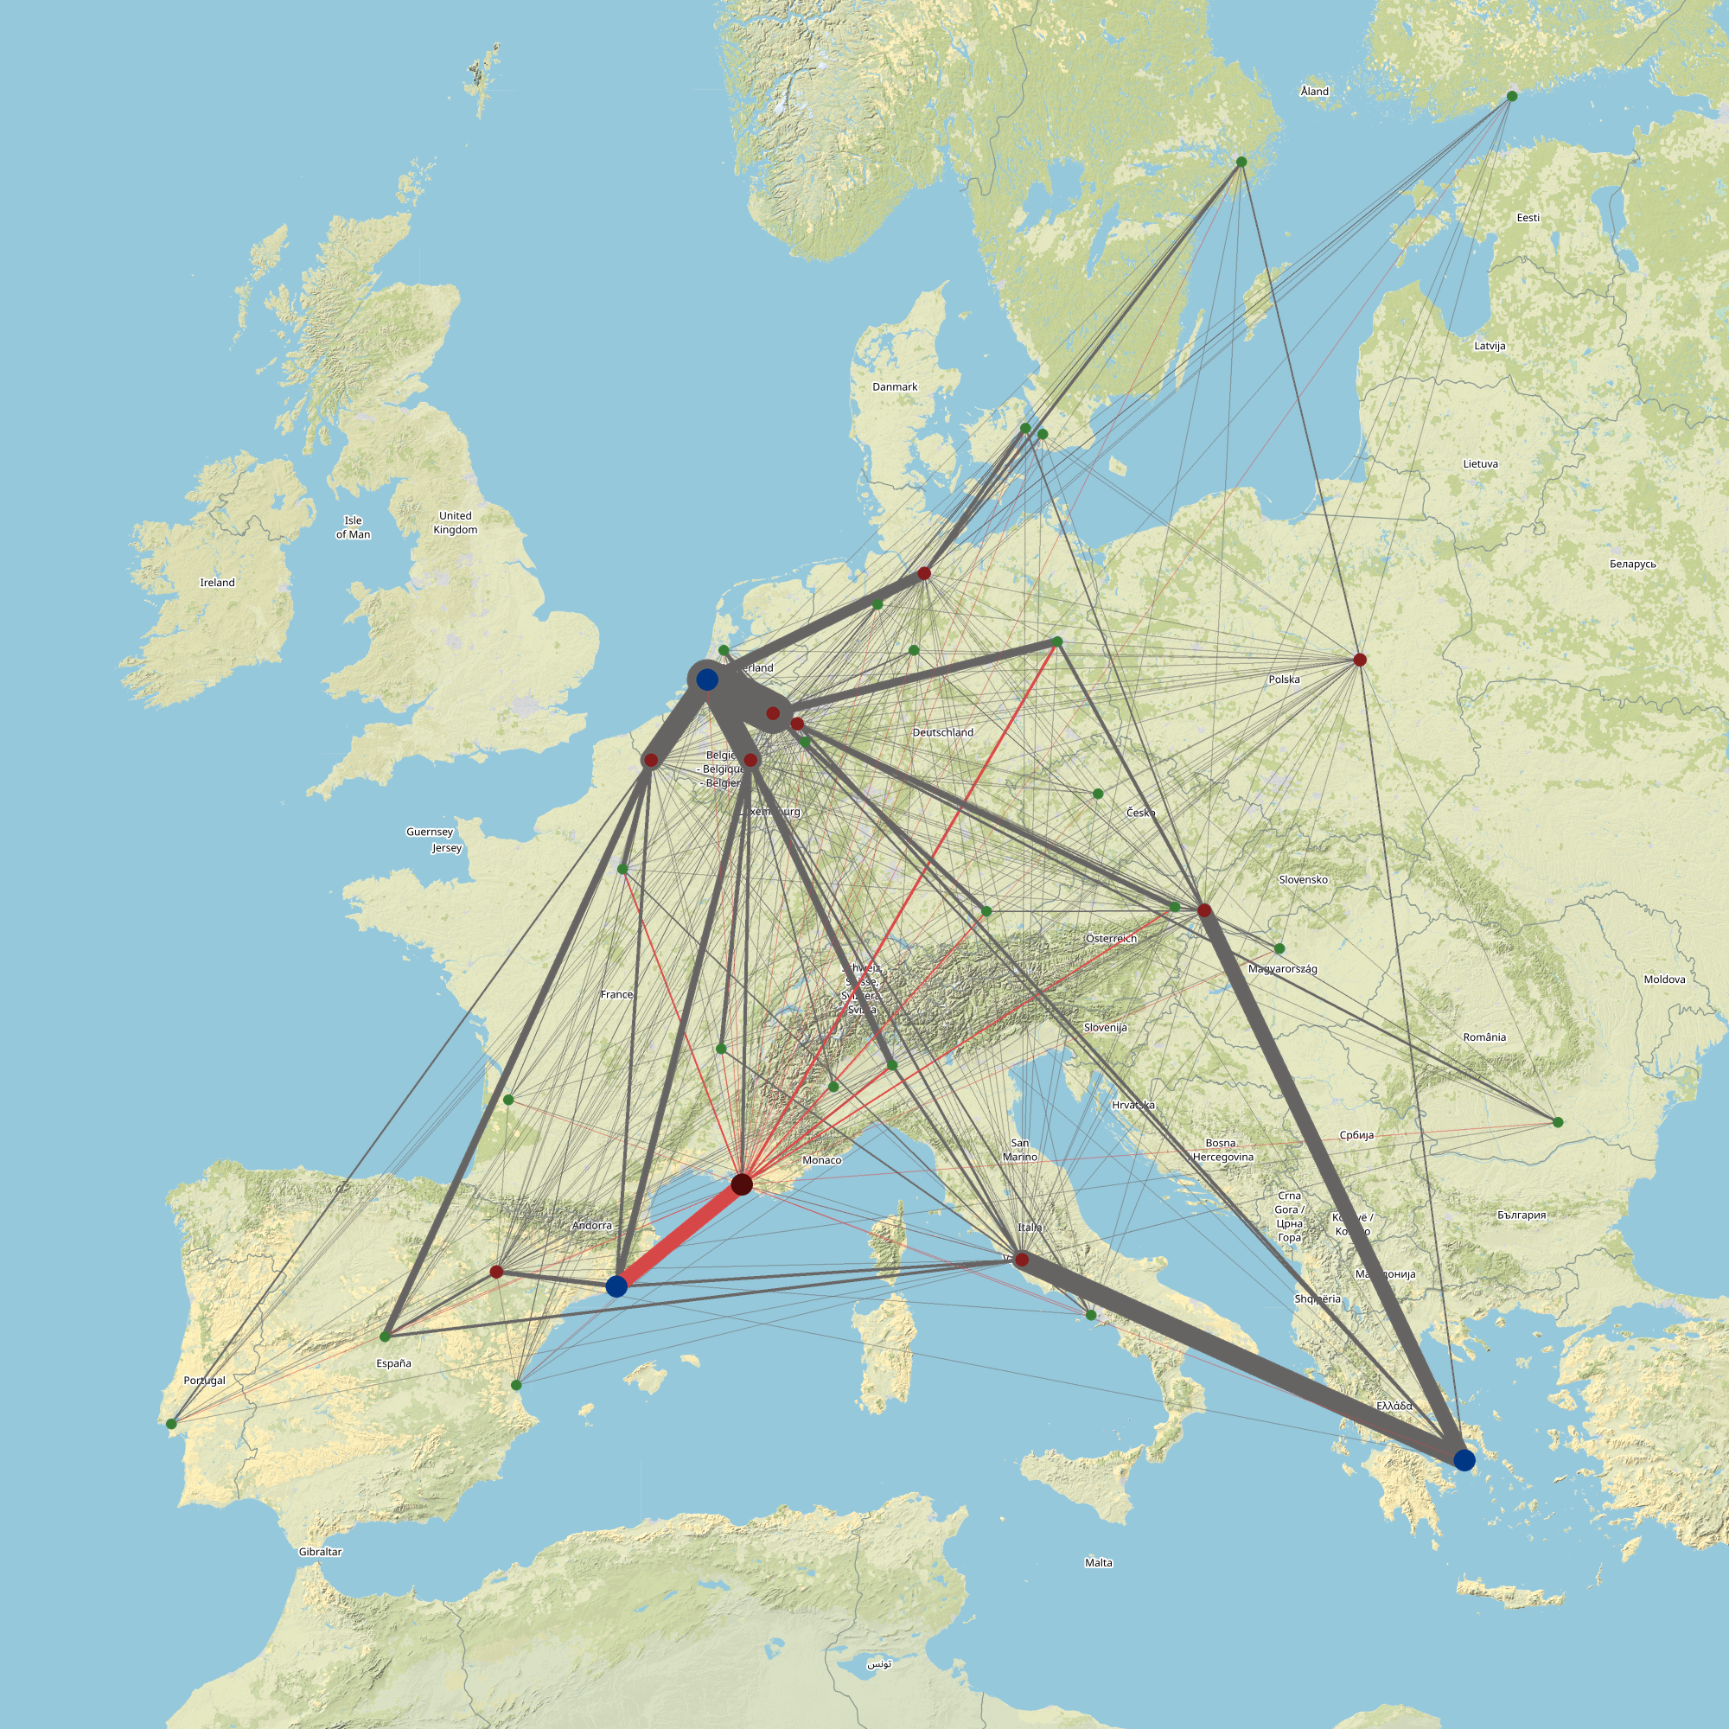
Reduce emissions : Least Greediness, Map
Marseille

Slide 10
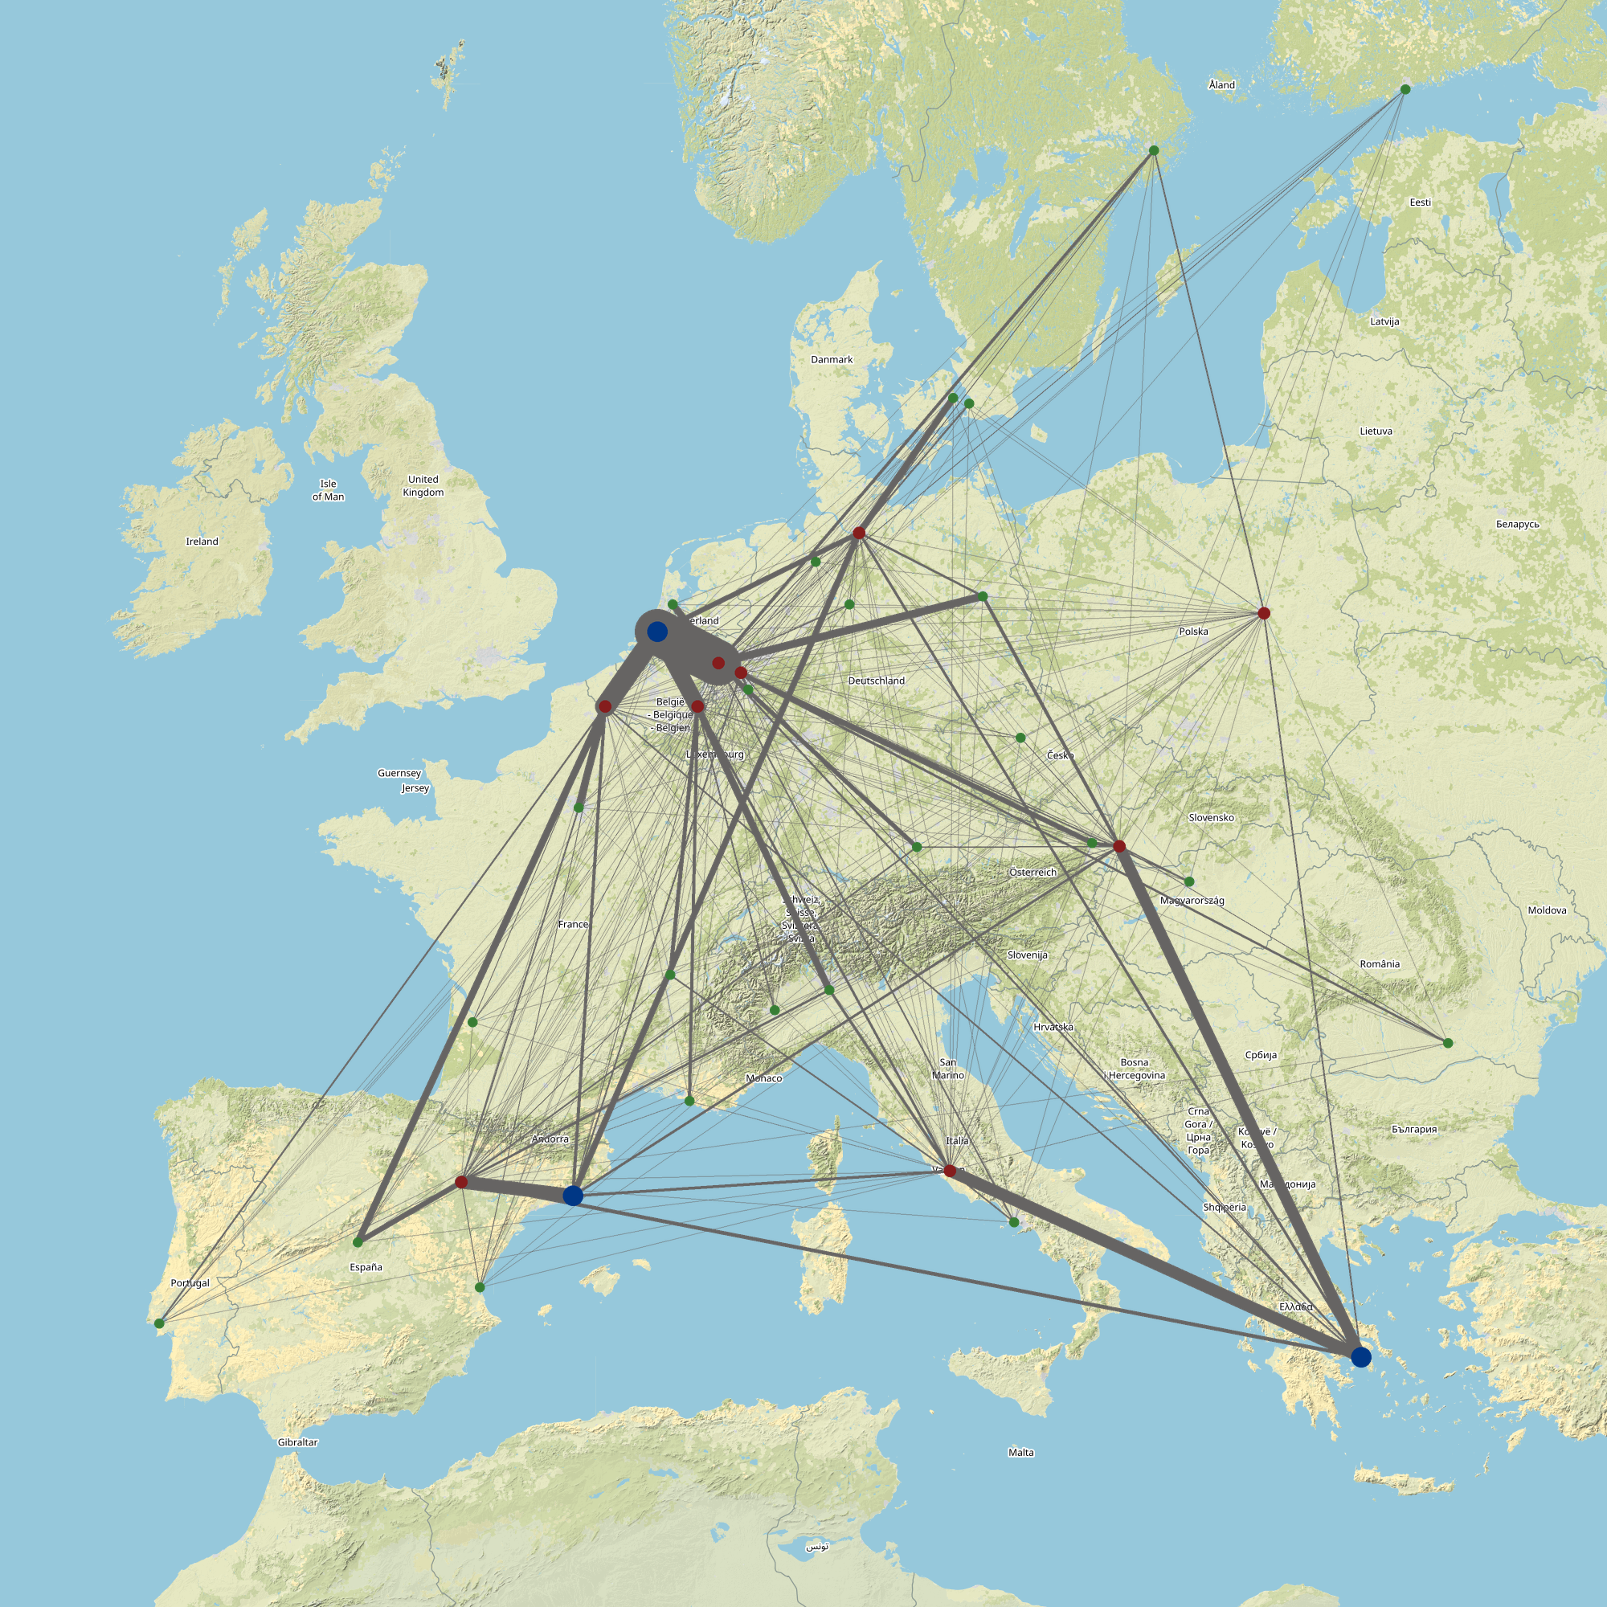

Mixed approach: Greediness is 50%, Map
Amsterdam

Slide 11

Long term effect of the optimization
Tendency to add Hubs and privilege a mix of profit and emission reduction -> reach COP emissions objectives in 2070 and increase profit by 10M $ annually

